Slide 1

.
Transamerica Financial Advisors, Inc.
TFA Investment Advisory Management Group
Presented to: Potential Client
Presented by: [Insert Name]*
Date: [Insert Date]
*[Insert Advisor Name] is an Investment Advisor Representative (IAR) with and offers securities and investment advisory services through Transamerica Financial Advisors, Inc., Transamerica Group Division, member FINRA , SIPC & Registered Investment Advisor
TFG1151423-0715

Slide 2
Table of Contents
History of Aegon and Transamerica
Transamerica Financial Advisors, Inc.
TFA Investment Advisory Management Group
Transamerica® ONE Wealth Management Platform
Proposal

Slide 3

History of Aegon and Transamerica
    Aegon is an international life insurance, pensions, and asset management company headquartered in The Hague, The Netherlands. Transamerica, part of the Aegon Group, is one of the world’s leading financial services companies, providing insurance, investments and more to 19.5 million customers.

Slide 4

History of Aegon and Transamerica
1920s
1972
1986
1991
Today
Bank of Italy
merges with Bank of America as Bank of America
The Pyramid, Transamerica’s new headquarters, is completed in San Francisco, California
Aegon buys the Baltimore-based life insurer Monumental Corporation
Aegon lists on the New York Stock Exchange
Transamerica operates under its own brand name in North America
Bank of Italy is founded in San Francisco, California
Bank of America acquires Occidental Life Insurance through a holding company named Transamerica
The Aegon we know today is founded following the merger of two Dutch insurance companies, AGO and Ennia
Aegon USA is headquartered in Cedar Rapids, Iowa
AEGON PURCHASES TRANSAMERICA
1904
1930s
1983
1988
1999

Slide 5
History of Aegon and Transamerica
Transamerica Financial Advisors, Inc.
TFA Investment Advisory Management Group
Transamerica® ONE Wealth Management Platform
Proposal

Slide 6
Transamerica Financial Advisors, Inc.
    Transamerica Financial Advisors, Inc. (“TFA”) is a full-service, fully licensed, independent Broker/Dealer and Registered Investment Advisor with over 25 years of experience. TFA has been a member of the Financial Industry Regulatory Authority (FINRA) since 1984. This enables the firm to provide a full range of financial products to our clients such as stocks, bonds, mutual funds and direct investments.

Slide 7
Transamerica Financial Advisors, Inc.
$12 Billion in Customer Assets
3,500 Registered Representatives
    350 Branch Offices Nationwide
    The SEC Registered Investment Advisor has over $3 billion in assets under administration (as of 12/31/2015), and has been serving its Investment Advisory Representatives and their clients since 1991. TFA’s flagship Transamerica ONE Wealth Management Platform is a separately managed account program featuring both institutional and boutique money managers.
Source: https://tfa.transamerica.com

Slide 8
History of Aegon and Transamerica
Investment Advisory Management Group
TFA Investment Advisory Management Group
Transamerica® ONE Wealth Management Platform
Proposal

Slide 9
TFA Investment Advisory Management Group
Transamerica Financial Advisors, Inc. is an SEC Registered Investment Advisor

Slide 10
TFA Investment Advisory
Management Group
3 Advisory Services Professionals
Average Industry Experience: 14 Years
6 Dedicated Professionals
Director, Advisory Services
Investment Management Professional

Slide 11
Our Team of Experts
TFA Investment Advisory
Management Group
George Chuang, CFA
President, Transamerica Financial Advisors, Inc.
Mr. Chuang began his career in the financial services industry in 1994. He received undergraduate degrees in Economics and Biology from the University of California, Irvine, and his MBA from the University of Southern California. Mr. Chuang holds the Chartered Financial Analyst (CFA) designation along with FINRA Series 7, 24, and 27 licenses.
Steven Gutke, CFA
Director, Investment Research
Mr. Gutke has been with Transamerica since 2009 and joined TFA as the Director of Investment Research in 2016. He earned a B.S. degree in Industrial & Systems Engineering from Georgia Institute of Technology and a Master’s Degree in Business Administration from the University of Indiana. Mr. Gutke has also earned the right to use the Chartered Financial Analyst (CFA) designation.
Scott Nishimura
Director, Advisory Services
Mr. Nishimura began his career in the financial services industry in 1994. He is a graduate of the University of Southern California and holds a B.S. in Business Administration with an emphasis in Marketing. Mr. Nishimura currently holds FINRA Series 7, 8, 24, and 63 licenses.
Chris Henderson
Senior Advisory Services Analyst
Mr. Henderson began his career in the financial services industry in 1994. He is a graduate of Central College where he earned a B.A. in English Literature. Mr. Henderson currently holds FINRA Series 4, 7, 24, 51, and 65 licenses and is a member of FINRA’s Series 6/26 Exam Review Committee.

Slide 12
Our Team of Experts
TFA Investment Advisory
Management Group
Rory Carney
Advisory Services Associate
Mr. Carney began his career in the financial services industry in 2009. He joined TFA in 2012 as a Commissions Specialist and joined TFA Advisory Services as an Associate in 2014. Mr. Carney is a graduate of Duquesne University where he earned his B.S. in Business Administration. He currently holds FINRA Series 6, 63, and 65 licenses.
Vicki Reighard-Kean
Lead Compliance Officer
Vicki Reighard-Kean has over 15 years of industry experience and was most recently the CCO and Vice President of Rep Resources at Berthel Fisher & Company Financial Services, Inc. Previously, Vicki held compliance positions with Ameritas and Raymond James. Vicki currently holds the Series 7, 24, 63 and 53 FINRA licenses.
Chelsea Palmer
RIA Operations Analyst
Ms. Palmer began her career in the financial services industry in 2016 as a RIA Operations Analyst. She is a graduate of the University of Tampa and holds a B.S. in Finance.

Slide 13
History of Aegon and Transamerica
Investment Advisory Management Group
TFA Investment Advisory Management Group
Transamerica® ONE Wealth Management Platform
Proposal

Slide 14
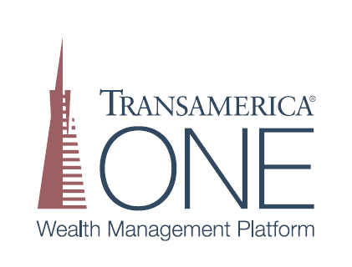
Transamerica® ONE Wealth Management Platform
Transamerica® ONE Wealth Management Platform is a separately managed account program which uses strategic, alternative, and tactical asset allocation models to establish an individualized client portfolio in accordance with the client’s particular investment objectives and risk tolerance.

Slide 15
History of Transamerica® ONE
Wealth Management Platform
March
2012
December 2013
June
2014
Today
Transamerica I-Series® is branded as the Transamerica Wealth Management Strategies (TWMS) Program for TFG
TWMS reaches
$371.5 Million in Assets Under Management
TWMS is re-branded to Transamerica® ONE Wealth Management Platform (Transamerica® ONE)
Transamerica® ONE is made up of 9 model managers and 56 investment options
Transamerica I-Series® Core Portfolios are launched with legacy TFA
TWMS crosses
$10 Million in Assets Under Management
Transamerica I-Series® and TWMS hit a combined $1 Billion in Assets Under Management
Transamerica® ONE reaches $615 Million in Assets Under Management
June
2007
July
2012
April
2014
December
2015

Slide 16
Transamerica® ONE Wealth Management Platform Overview
Professional Investment
    Diversification
Risk Management
Simplicity

Slide 17
Transamerica® ONE Wealth Management Platform Overview
Multiple Model Portfolios within a Single Account
ETFs, ETNs,
and Mutual Funds
Within Transamerica® ONE, clients may select multiple model portfolios allowing them to pursue different investment strategies within a single account.
Depending upon the models selected, the underlying assets may include Exchange Traded Funds (ETFs), Exchange Traded Notes (ETNs) and/or mutual funds. Each Transamerica ONE® client owns the underlying securities in his or her account.

Slide 18
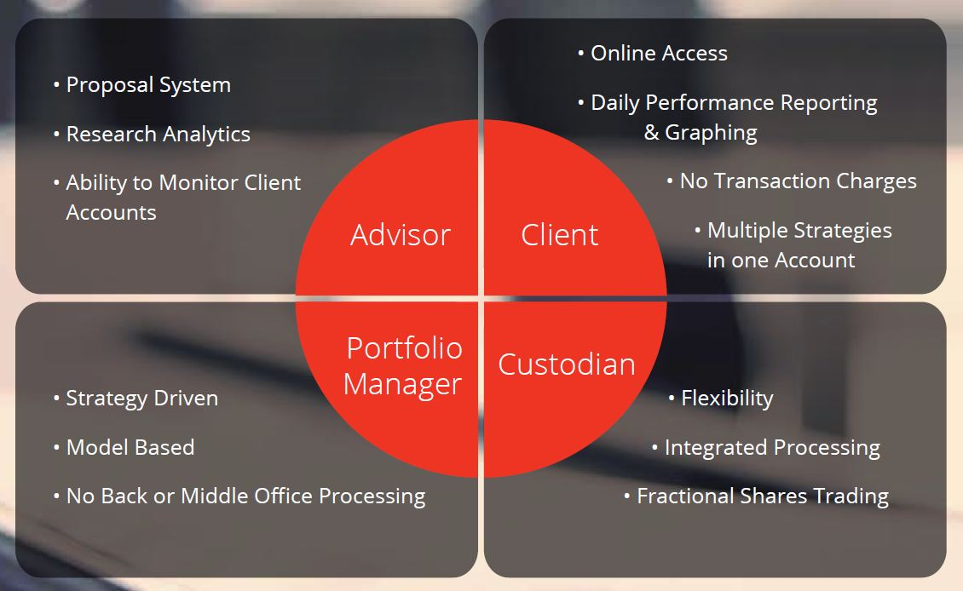
Transamerica® ONE Wealth Management Platform Overview

Slide 19
Transamerica® ONE Wealth Management
Platform Overview
Core/satellite investing is a method of portfolio construction designed to help minimize costs, tax liability, and volatility while providing an opportunity to outperform the broad stock market as a whole. The core of the portfolio consists of passive investments that track major market indexes. Additional positions known as satellites, are added to the portfolio in the form of actively managed investments.
Alpha
Strategy
Core
Risk Target Allocation
Alpha
Strategy
Alpha
Strategy

Slide 20




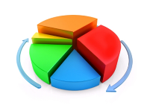


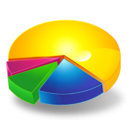
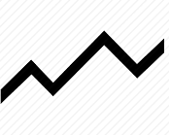
Transamerica® ONE Wealth Management
Platform Overview
Satellite (Alpha)
Core (Beta)
  Market portfolios using index funds or ETFs
  Low correlation to the market
  Managing downside risks
  LOW EXPENSES
  Alternative asset classes or allocations
  Global diversification and mean variance optimization
  Focus on inefficiencies in the market and short term market trends
  MINIMIZE active manager risk and reduce market risk
  Exposure to active manager and market risk

Slide 21
Transamerica® ONE Wealth Management Platform Core Portfolios
Core Portfolio
I
Ultra Conservative
Core Portfolio
II
Conservative
Core Portfolio
III
Moderate Conservative
Core Portfolio
IV
Moderate
Core Portfolio
V
Moderate Aggressive
Core Portfolio
VI
Aggressive
Global Fixed Income (GFI) Core Model Portfolio
Strategic Alternative Core Model Portfolio
Social Impact Growth
Commodity and municipal overlays are available for Portfolios I-V. Portfolio VI is only available with the commodity overlay. Portfolio VI is not available with the municipal overlay.

Slide 22

Transamerica® ONE Wealth Management Platform Core Global Diversification
Argentina | Australia | Austria | Belgium | Brazil | Canada | Cayman Islands | Chile | China | Colombia
Cyprus | Czech Republic | Denmark | Egypt | Estonia | France | Finland | Germany | Ghana | Greece
Guernsey | Hong Kong | Hungary | India | Indonesia | Ireland | Israel | Italy | Japan | Jordan
Kazakhstan | Kenya | Kuwait | Lebanon | Luxembourg | Macao | Malaysia | Malta | Marshall Islands | Mauritius
Mexico | Monaco | Mongolia | Morocco | Mozambique | Netherlands | Netherlands Antilles | New Zealand | Nicaragua | Nigeria
Norway | Oman | Panama | Pakistan | Peru | Philippines | Poland | Portugal | Puerto Rico | Qatar
Romania | Russia | Saudi Arabia | Singapore | Slovenia | South Africa | South Korea | Spain | Sri Lanka | Swaziland
Sweden | Switzerland | Taiwan | Thailand | Turkey | Ukraine | United Arab Emirates | United Kingdom | United States | Zimbabwe
80 Countries

Slide 23
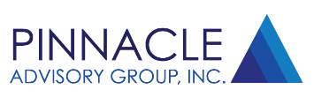




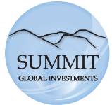


Transamerica® ONE Wealth Management Platform Satellite Managers
Tactical Allocation Managers
Active Asset Class Managers

Slide 24

Disclosure
The underlying securities in the advisory programs are subject to market risk and an investor may experience loss of principal. For a complete description of all fees, costs, and expenses, please refer to the Form ADV Part 2A and/or Appendix 1.
Transamerica Financial Advisors, Inc., member FINRA and SEC Registered Investment Advisor
570 Carillon Parkway, St. Petersburg, FL 33716
Follow Us
@TransamericaTFA

